Slide 1

Chapter 5
The Relational Data Model and Relational Database Constraints

Slide 2
INFORMAL DEFINITIONS
RELATION: A table of values
Collection of information organized in tables
  set of rows.
  set of columns.
Each row represents a fact that corresponds to a real-world entity or relationship.
  Each row has a value of an item or set of items that uniquely identifies that row in the table.
  Sometimes row-ids or sequential numbers are assigned to identify the rows in the table.
  Each column typically is called by its column name or column header or attribute name.

Slide 3
FORMAL DEFINITIONS
A Relation may be defined in multiple ways.
The Schema of a Relation: R (A1, A2, .....An)
Relation schema R is defined over attributes A1, A2, .....An
For Example –
CUSTOMER (Cust-id, Cust-name, Address, Phone#)
Here, CUSTOMER is a relation defined over the four attributes Cust-id, Cust-name, Address, Phone#, each of which has a domain or a set of valid values. For example, the domain of Cust-id is 6 digit numbers.

Slide 4
FORMAL DEFINITIONS
A tuple is an ordered set of values
Each value is derived from an appropriate domain.
Each row in the CUSTOMER table may be referred to as a tuple in the table and would consist of four values.
<632895, "John Smith", "101 Main St. Atlanta, GA 30332", "(404) 894-2000">
is a tuple belonging to the CUSTOMER relation.
A relation may be regarded as a set of tuples (rows).
Columns in a table are also called attributes of the relation.

Slide 5
DEFINITION SUMMARY
Informal Terms |  | Formal Terms
Table |  | Relation
Column |  | Attribute/Domain
Row |  | Tuple
Values in a column |  | Domain
Table Definition |  | Schema of a Relation

Slide 6
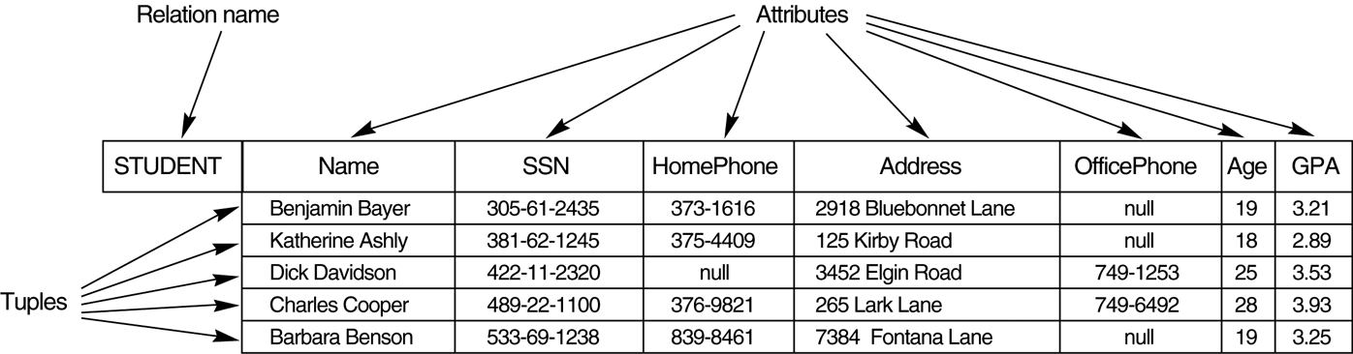
Example – STUDENT table

Slide 7
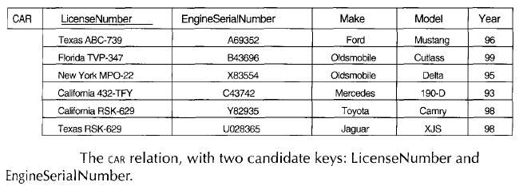
Key Constraints

Slide 8
Tables are related through common fields designated as primary and foreign keys
Allow us to find, update, and delete data quickly, and help to ensure accuracy

Slide 9
Primary and Foreign Key Fields
Primary Key
  Primary key fields must be unique and cannot contain a null value.
  Each table should have a primary key field.
  Concatenated keys: using more than one field as a primary key field.
Foreign Key: Fields in a table that refer to the primary key in another table
  The data in this field must exactly match data contained in the primary key field.

Slide 10
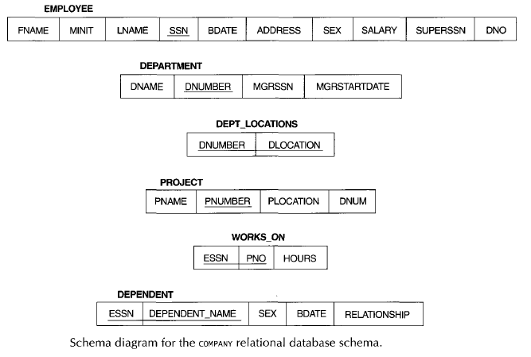

Slide 11
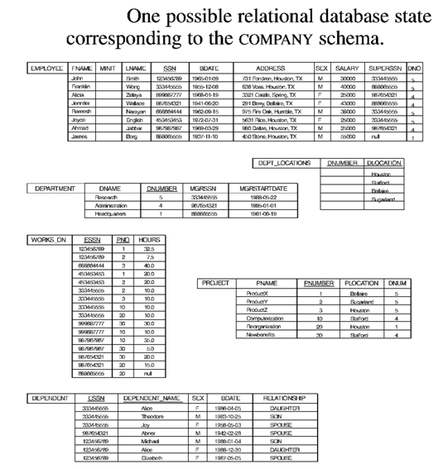

Slide 12
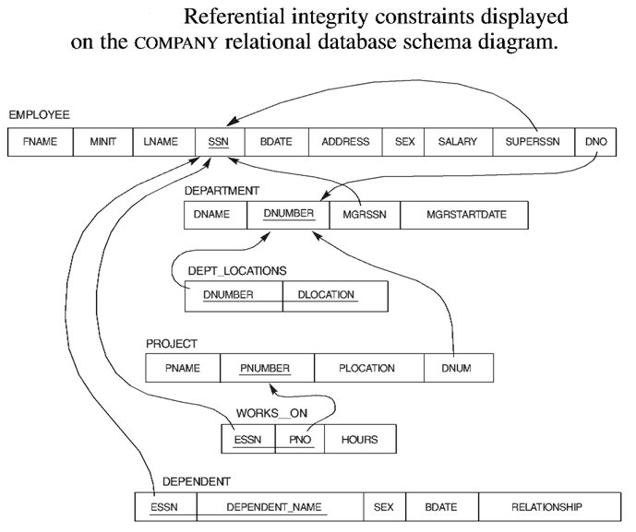

Slide 13
Update Operations on Relations
INSERT a tuple.
DELETE a tuple.
MODIFY a tuple.
Several update operations may have to be grouped together.
Updates may propagate to cause other updates automatically. This may be necessary to maintain integrity constraints.

Slide 14
In-Class Exercise
Consider the following relations for a database that keeps track of student enrollment in courses and the books adopted for each course:
STUDENT(SSN, Name, Major, Bdate)
COURSE(Course#, Cname, Dept)
ENROLL(SSN, Course#, Quarter, Grade)
BOOK_ADOPTION(Course#, Quarter, Book_ISBN)
TEXT(Book_ISBN, Book_Title, Publisher, Author)
Draw a relational schema diagram specifying the foreign keys for this schema.

